Slide 1
L.D COLLEGE OF ENGINEERING
ENVIRONMENT SCIENCE
Global Environment Issue
Group number:7

Slide 2
Contents
INTRODUCTION
01
Sustainable Development & Climate change
02
Global warming & green house effect
03
Acid rain & Ozone layer depletion
04
Carbon footprint &CDM
05

Slide 3
★Introduction:
The factors disturbing the global ecosystem are :
1. Population explosion
2. Rapid industrializatio
3. Urbanization
4. Modern life style, etc.

Slide 4
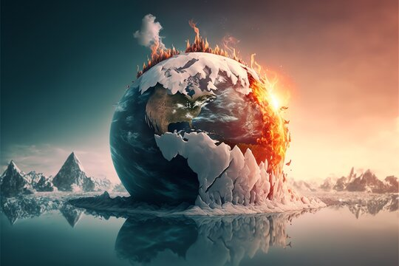
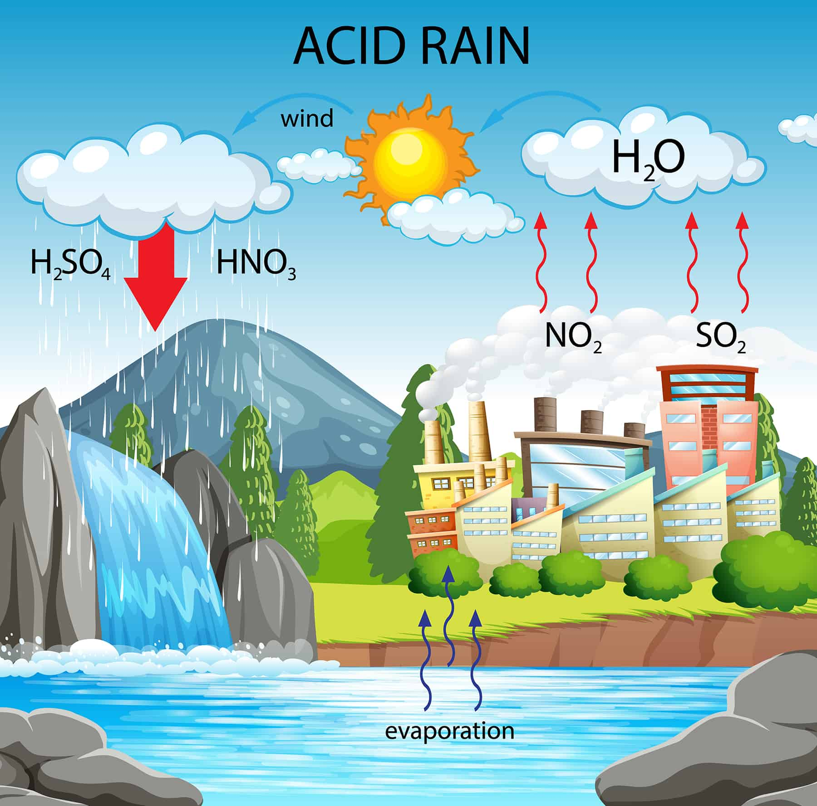
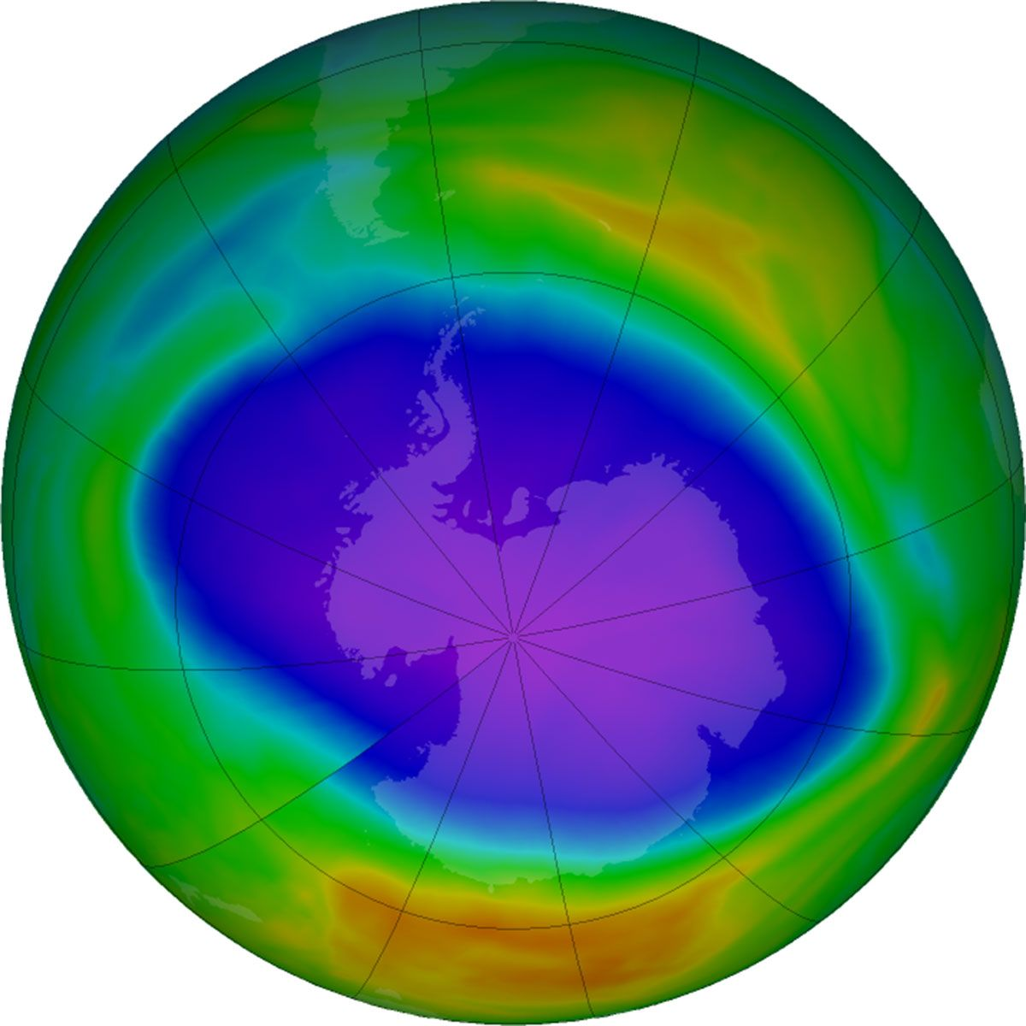
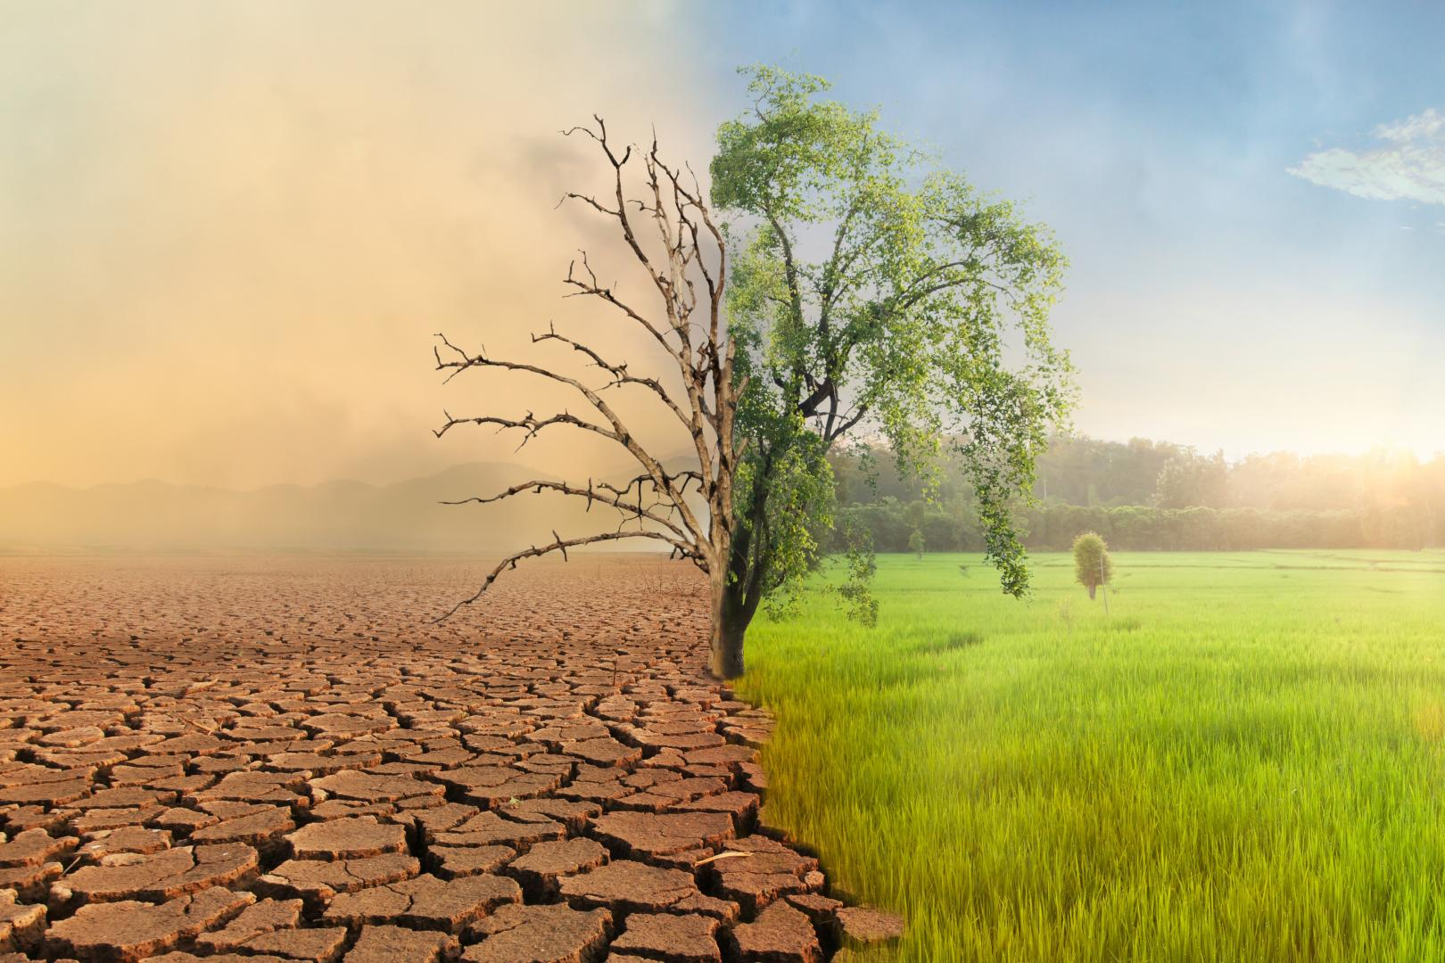
All these factors are responsible for the following globl environmental problems:
Global environment problem
Climate Change
Global warming & green house effect
Acid rain
Ozone layer depletion

Slide 5
1. Sustainable Development :
"Sustainable development is defined as a form of development or
progress that meets the needs of the present without compromising the ability of future generations to meet their own needs."
Sustainable development is a process of betterment of life in all the sectors like economic, social, educational, health, sanitation, food and housing, national security, etc. It means, every generation should leave air, water and soil,
pure and unpolluted as possible, so that the next future generation is not
jeopardize of their needs. Although, it is difficult thing, it can be achieved through proper environmental management,
In 1987, the 'World Commission on Environment and Development' made sustainable development on the theme of its report "our common future".

Slide 6
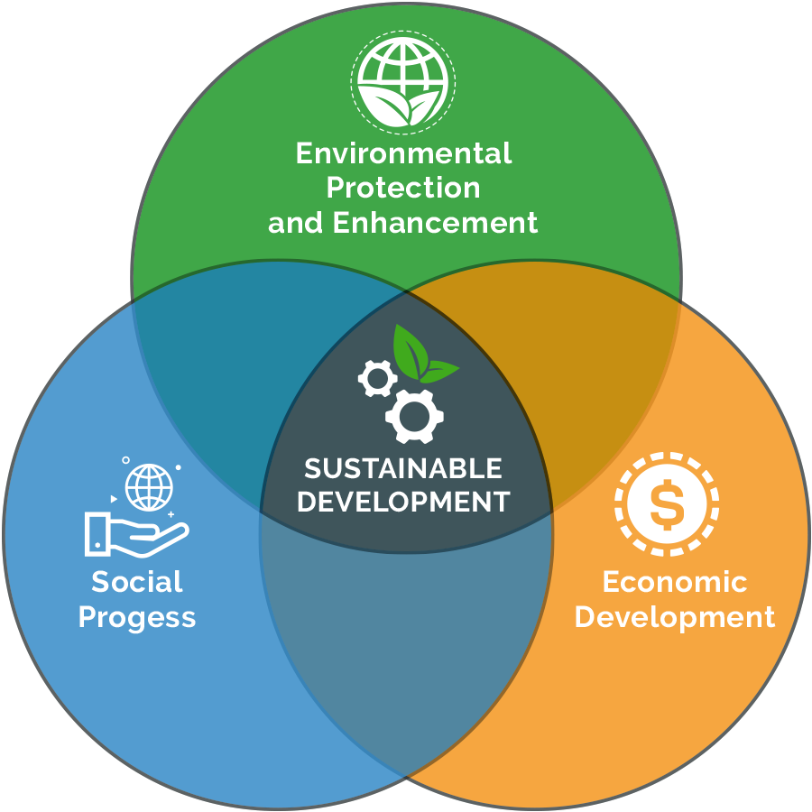
★ The three important components highlighted in this report are:
1.Economical Development
2 .Social Development
3 .Environmental
Development

Slide 7
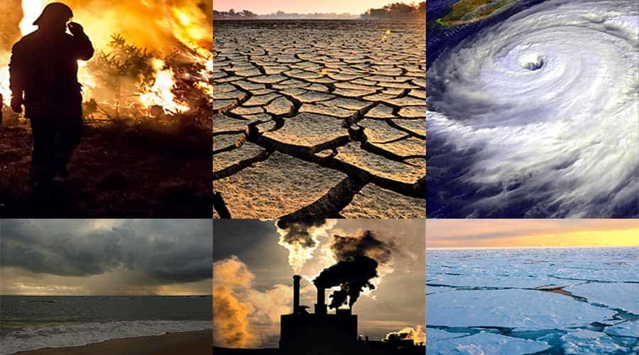
2. Climate Change :
"Climate change refers to any significant change in climatic factors such as temperature, wind precipitation, lasting for an unexpected period. "
The term climate change is very often used inter changeably with the global
warming. But, the term global warming
refers to rise in temperature of earth,
while climate change refers to other
changes addition to global warming.

Slide 8
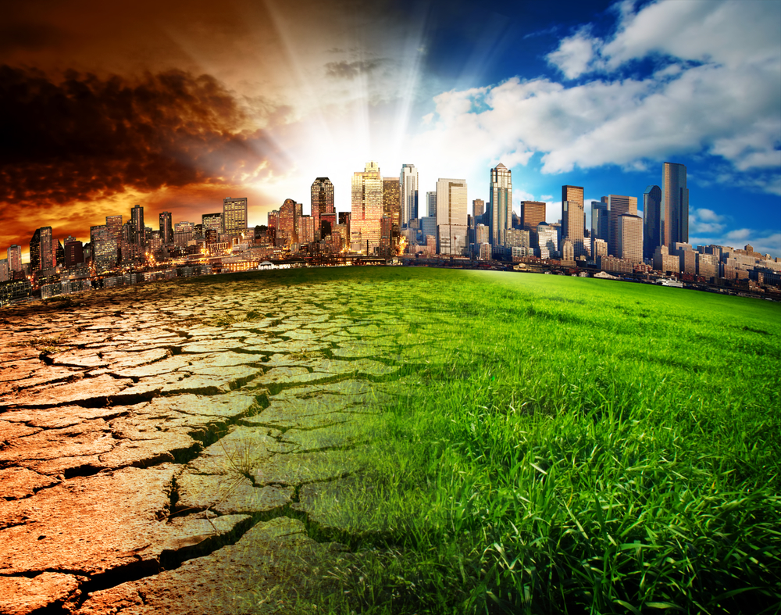
Causes of climate change:
1. Change in the sun's intensity.
2. Slow changes in the Earth's orbit around the sun.
3. Change in ocean circulation.
4.Human activities that change the composition of atmosphere and land e.g
1.burning fossil fuels
2 .deforestation
3. desertification
4.urbanization
5.industrialization, etc.

Slide 9
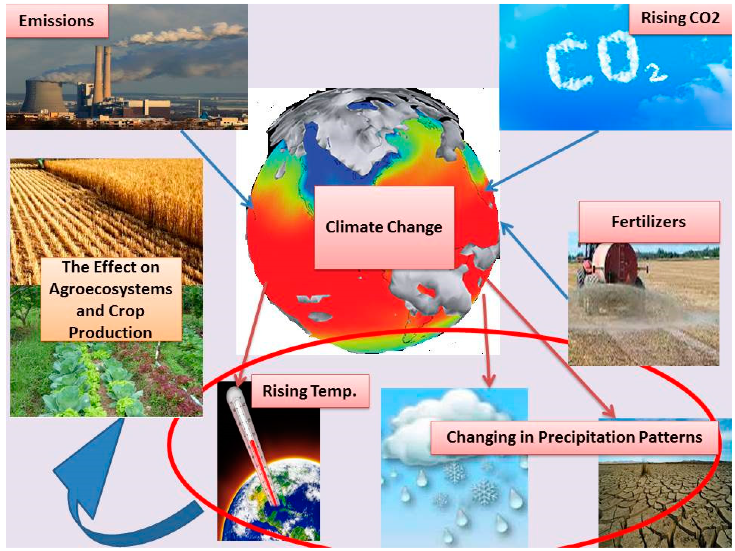
1.extreme hot and cold spells of temperature
2.wet or dry spells of rainfall
3.cyclones
4.Floods
5.rise in sea level
6.global warming
Effects of climate change:
Key signs of climate change:
1.Increase in global concentration of CO2
2.Increase in global temperature:
3.Sinking of ice sheets
4.Sea level rise:

Slide 10
3.Global warming
What is Global Warming?
Global warming is the phenomenon of a gradual increase in the temperature near the earth’s surface. This phenomenon has been observed over the past one or two centuries. This change has disturbed the climatic pattern of the earth. However, the concept of global warming is quite controversial but the scientists have provided relevant data in support of the fact that the temperature of the earth is rising constantly.
There are several causes of global warming, which have a negative effect on humans, plants and animals. These causes may be natural or might be the outcome of human activities. In order to curb the issues, it is very important to understand the negative impacts of global warming.

Slide 11
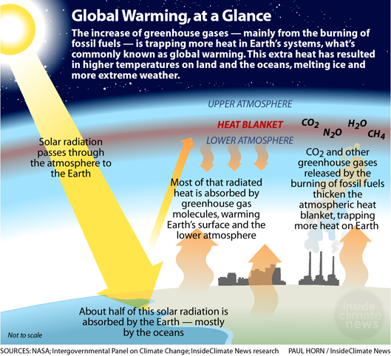
Global warming diagram

Slide 12
Causes of Global Warming
1.Man-made Causes of Global Warming
1.Deforestation
Plants are the main source of oxygen. They take in carbon dioxide and release oxygen thereby maintaining environmental balance. Forests are being depleted for many domestic and commercial purposes. This has led to an environmental imbalance, thereby giving rise to global warming.
2.Use of Vehicles
The use of vehicles, even for a very short distance results in various gaseous emissions. Vehicles burn fossil fuels which emit a large amount of carbon dioxide and other toxins into the atmosphere resulting in a temperature increase.
3.Agriculture
Various farming activities produce carbon dioxide and methane gas. These add to the greenhouse gases in the atmosphere and increase the temperature of the earth

Slide 13
2.Natural Causes of Global Warming
1.Volcanoes
Volcanoes are one of the largest natural contributors to global warming. The ash and smoke emitted during volcanic eruptions goes out into the atmosphere and affects the climate.
2.Water Vapour
Water vapour is a kind of greenhouse gas. Due to the increase in the earth’s temperature, more water gets evaporated from the water bodies and stays in the atmosphere adding to global warming.
3.Forest Blazes
Forest blazes or forest fires emit a large amount of carbon-containing smoke. These gases are released into the atmosphere and increase the earth’s temperature resulting in global warming

Slide 14
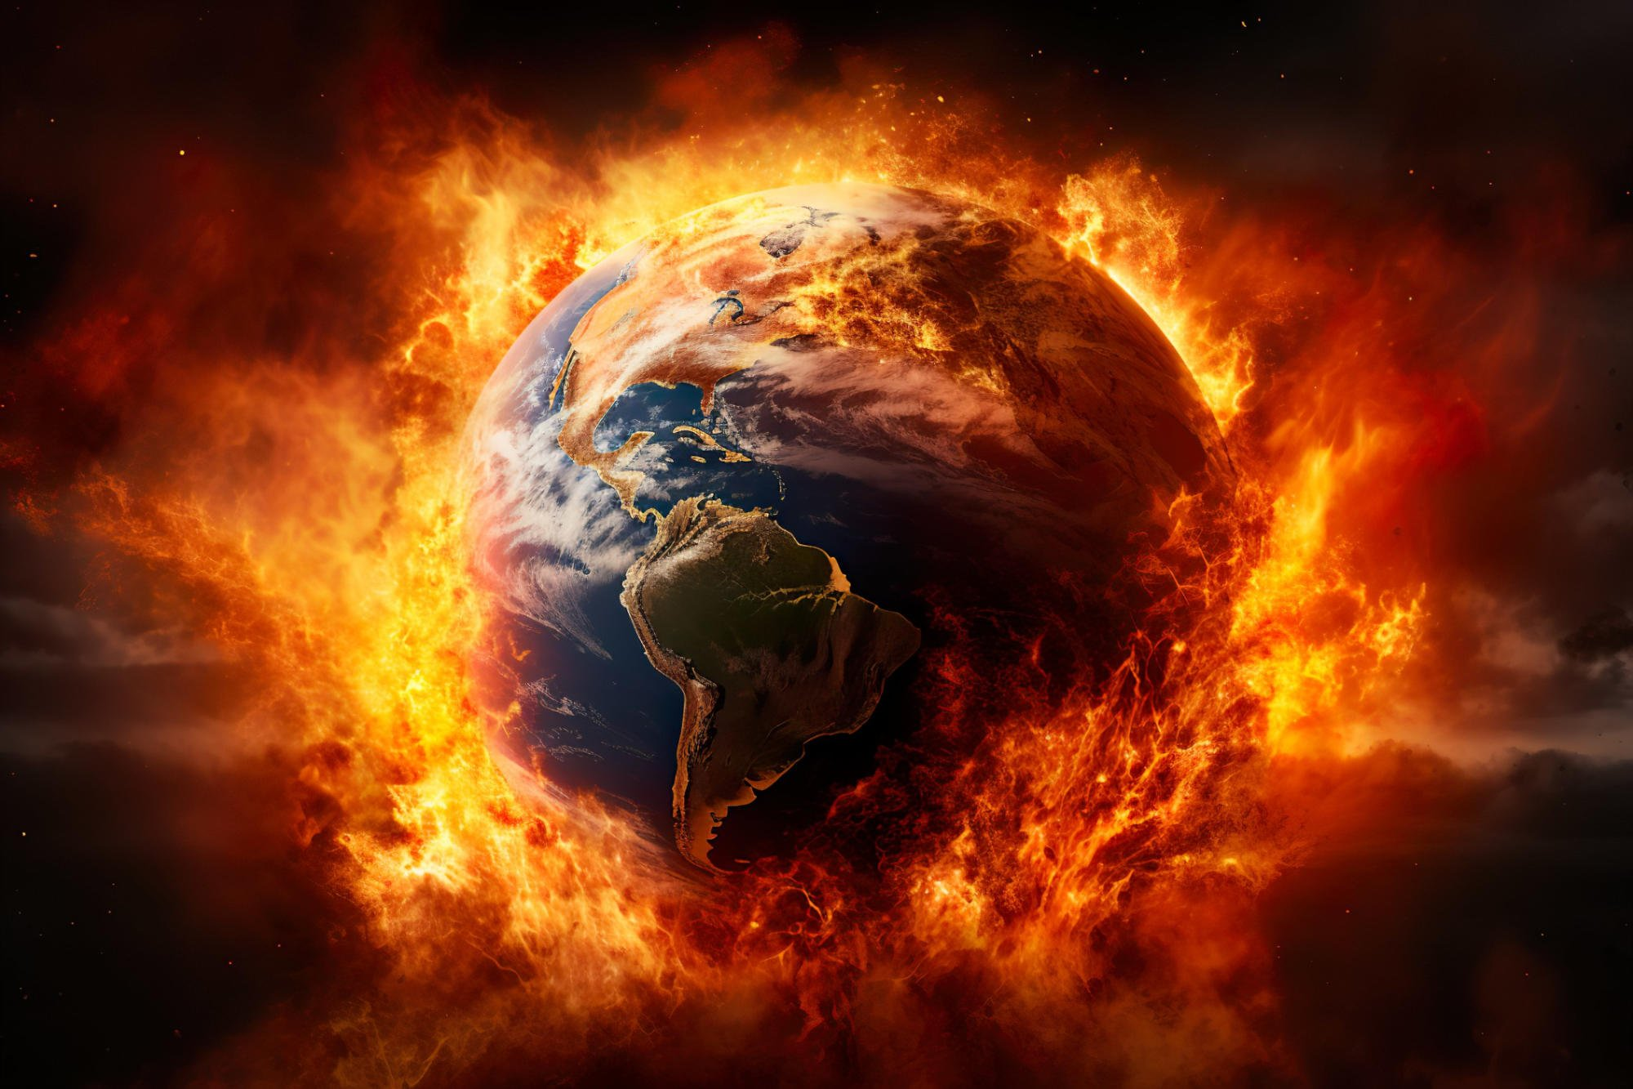
Effects of Global Warming
Following are the major effects of global warming:
1.Rise in Temperature
2.Climate Change
3.Spread of Diseases
4.Threats to the Ecosystem
5.More health risks
6.Poverty and displacement

Slide 15
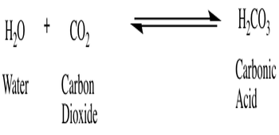
4. ACID RAIN:
"When the ph of rain water is less than 5.6, it is called acid rain."
We know that, rain water (natural water) as it falls should be neither acidic nor alkalineIt should be neutral, ie pH=7 But, in reality it is not so because of the. dissolution of atmospheric CO2 in rainwater to make carbonic acid which imparts slight acidity to rainwater.
USA and other industrialized countries faced problem of acid rain with pH of 5.0 to 2.2. The phenomenon of acid rain has also been observed in cities like Kanpur and Mumbai

Slide 16
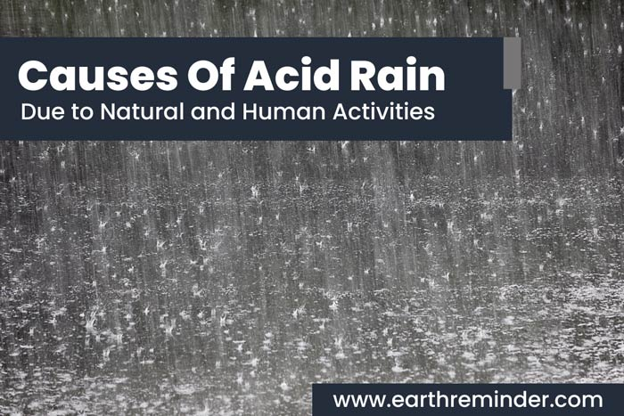
The reduction in pH of rainwater is basically due to the dissolution of oxides of nitrogen and sulphur present in the atmosphere which forms nitric acid (HNO3) and sulphuric acid (H2so4) .
Causes of acid rain:
1. Dissolution of SO_{2} and NO_{2} formed by the burning of fossil fuels into rain water.
2. Dissolution of oxides of sulphur. and nitrogen released from the chimneys of smelting industries and automobile exhaust
3.plants using sulphuric acid and nitric acid.

Slide 17
Effect of Acid Rain
1. Acid rain is very harmful to agriculture and plants, . It washes away all nutrients which are required for the growth and survival of plants.
2. Acid rain affects agriculture by the way it alters the composition of the soil.
3. It causes respiratory issues in animals and humans.
4. When acid rain falls down and flows into the rivers and ponds it affe-cts the aquatic ecosystem. It alters the chemical composition of the water, to a form whichi s actually harmful to the aquatic ecosystem to survive and causes water pollution.
5. Acid rain also causes the corrosion of water pipes, which further results in leaching of heavy metals such as iron, lead and copper into drinking water.
6. It damages the buildings and monuments made up of stones and metals.
Like taj Mahal

Slide 18
Control of acid rain:
1. Decreasing the emissions of sulphur dioxide (SO2) and nitroges oxide (NO2)
2. Adopting energy conservation measures.
3. Using less coal in power plants and utilizing non-polluting energy. sources.
4. Lakes and soil that are extremely acidified can be treated with lime to rejuvenate them.
5. Release of SO_{2} can be controlled by adopting suitable SO2 reducing equipments in industries and thermal power plants.
6. Natural gas can be used in place of high-sulphur coal for producing electricity in thermal power plants.

Slide 19
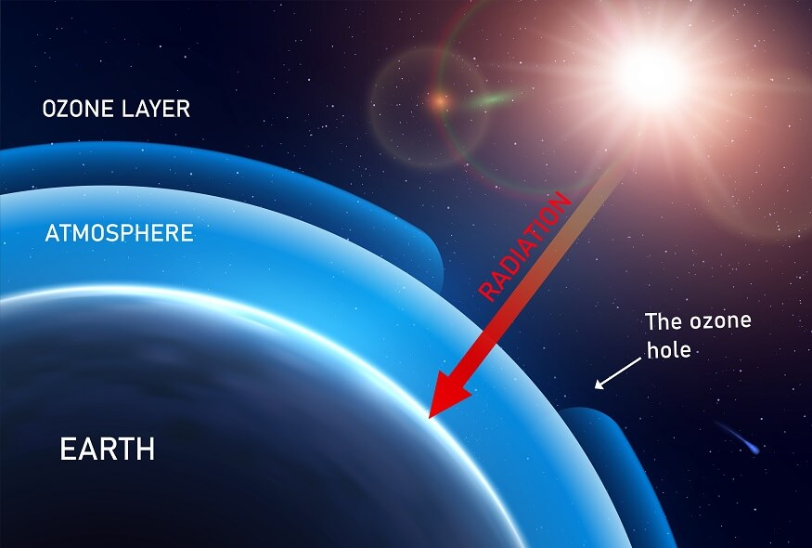
5. OZONE LAYER DEPLETION:
"The layer in the upper atmosphere (stratosphere), some 15 to 30 km above the earth's surfae, in which most of the atmo-spheric ozone (about 90%) is concentrated is called the ozone layer."
The ozone layer, absorbs most of the sun's ultra violet (uv) radiation and protects various life form the earth. It acts like a natural sunscreen for the earth. Therefore, the ozone layer is often called the one shield for earth's protective umbrella.

Slide 20
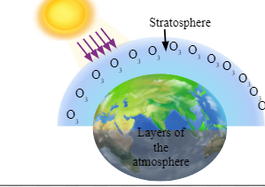
Formation of ozone:
In the stratosphere, the formatsion and destruction of ozone is a continuous
phenomenon. In the osphere, UV radiation splits oxygen molecule into oxygen atoms, which combine with other oxygen molecules to form ozone

Slide 21
Destruction of ozone layer
The main chemicals responsible for zone layer depletion are chloro fluoro carbons (CFCs) and chlorofluoro bromines (CFBr).
Among the CFCs, the main chemicals responsible for ozone depletion are referred to by trade names such as
Feron 11 (C Cl, F)
Feron-12 (C Cl₂ F₂)
They are largely used, and subsequently released into the atmosphere, by the following activition:
(i) Refrigeration
(iii) Extinguishing fires
(1) Air conditioning
(iv) Cleaning solvents in industries
(v) Solvent in paint industry
(vi) Blowing agents in plastic industries
(iii) Extinguishing fires
(1) Air conditioning
(iv) Cleaning solvents in industries
(v) Solvent in paint industry
(vi) Blowing agents in plastic industries
Scanned

Slide 22
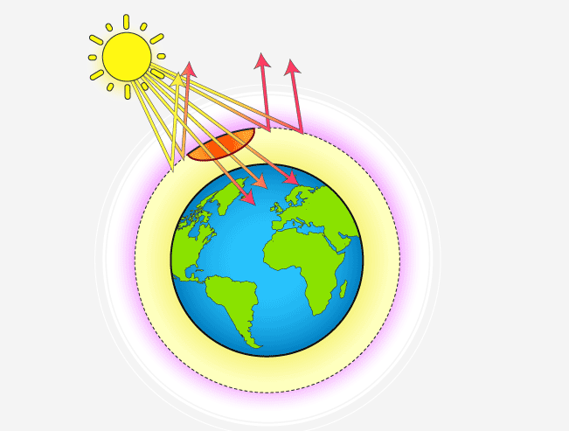
Ozone hole
The cold environment forms tiny ice crystals and these crystals get accumulated, as very cold temperatures build up due to long nights. The CFCs brought from lower levels get attached to the tiny ice crystals. The CFCs may also breakdown into chlorine monoxide (CIO). Finally, when rises after a long night period, its light triggers a massive destruction of ozone by CIO. This vast depletion of ozone at that level in the stratosphere makes the ozone layer very thin. This is called formation of ozone hole.

Slide 23
Effects of Ozone Depletion:
Ozone depletion in the stratosphere will result in more UV radiation reaching the earth especially UV-B (200- 280 nm). The UV-B radiations affect DNA and the photosynthetis chemicals. Any change in DNA can result in mutation and cancer. Cases of skin cancer which do not cause death but cause disfigurement will increase.
Easy absorption of UV rays by the lens and cornea of eye will result in increase in incidenti of cataract.
Melanin producing cells of the epidermis will be destroyed by UV-rays resulti-ng in immun suppression. Fair people (can't produce enough melanin) will be at a greater risk of LIV exposure

Slide 24
6.CARBON FOOTPRINT
The carbon footprint is a measure of the total amount of Carbon Dioxide (CO₂) and other greenhouse gas emissions that are directly or indirectly caused by an activity, or which are accumulated over the life qua of a product, person, an organization, or even a city or state. Carbon foot printing is a mearure by which a company or individual can calculate how much carbon emissions they have produced during a project or time.
A carbon footprint is made up of the sum of two parts:
Primary footprint:
Secondary footprint:

Slide 25
Benefits of carbon footprint
Calculating carbon footprint and taking measures to reduce it yields many environmental, social and economic benefits. Some of the benefits are:
(1)an effective tool for ongoing energy and environmental management. It helps in reducing emissions over time.
(ii) It helps in reducing waste thus reducing cost of materials.
(iii) It helps to determine what quantity of emissions they need to offset for them to become "carbon neutral
(v) It can be used to report the footprint accurately to a third party.
(vi) It helps in measuring changes in emissions over time, and monitoring the effectiveness of reduction activities.

Slide 26
7.CLEANER DEVELOPMENT MECHANISM
The UN's Kyoto protocol [ Japan-1997 Jestablished binding greenhouse gas emissions reduction targets For 37 industrialized countries and the European community. To help achieve these targets, the protocol introduced three "flexible mechanisms" international emissions trading (IET), joint implementation Un and the clean development Mechanism (CDM)
The Clean Development Mechanism (CDM), defined in Article 12 of the Protocol, allows a country with an emission-reduction or emission-limitation commitment under the Kyoto Protocol (Annex B Party) to implement an emission-reduction project in developing countries.

Slide 27
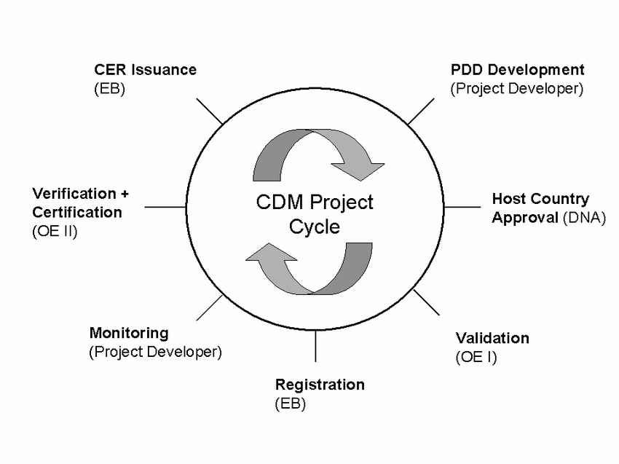
The Project Cycle in CDM:

Slide 28
Benefits of CDM:
The main benefits of CDM are:
Sustainable development
Conservation of environment reduction of GNG emissions.
Reduction in climate change phenomenon
CDM projects include investment in climate change mitigation projects in developing countries.
Transfer of technology in the host countries,
Improvement in the livelihood of communities through the creation of employment or increased economic activity.
Social and economic development in the host country.

Slide 29
Challenges for CDM:
High methodology rejection rates.
DNA (Designated National Authority) approval capacities.
Gap between CER and EU allowance prices.
Annex I companies may only be interested in buying CER, not in investing CDM projects
Interpretation of national policies in baseline methodologies. Availability of reliable and authentic data for establishing baselines.

Slide 30
8. INTERNATIONAL STEPS FOR MITIGATING GLOBAL CHANGE:
A list of UN Conferences & Protocols on Environment, Sustainable Development, Climate Change is a under
1.Earth summit:
The United Nations conference on Environment and Development, the Earth summit, held at Rio de Janeiro, Brazil in 1992, established principles to reduce green house gases.
Objectives of the summit were:
1.to secure renewed political commitment to sustainable development.
2.to address new and emerging challenges.
3.green economy and poverty eradication
4.sustainable development.

Slide 31
2.Kyoto protocol:
In December 1997, an international conference was held at Kyoto, Japan to discuss climate change The conference was attended by 37 industrialized countries and the European community for reducing green house gases.
It was decided that the countries will reduce the green house emission by 5% compared to 1990 level up to 2012.
Another protocol list are:
1.United Nations Framework Convention on Climate Change (1992)
2.Vienna Convention (1985) (Protection of Ozone Layer)
3.Montreal Protocol (1989) (Total Elimination of Ozone Depleting
Substances)
4.Basal Convention (1989) (Control of Trans-boundary Movements of
Hazardous waste)
5.Geneva Convention (1990)

Slide 32



THANK YOU
Save Earth, green Earth

